Slide 1
APPLICATION OF FACEBOOK'S PROPHET ALGORITHM FOR SUCCESSFUL SALES FORECASTING BASED ON REAL-WORLD DATA
Présenté par Jean Luc MAHOP

Slide 2
PLAN
BRIEF INTRODUCTION & CONTEXT OF THE PAPER
THE PROBLEM OF SALES FORECASTING
PRESENTATION OF PRINCIPLES APPROACHES
THE PROPHET METHODOLOGY
PRACTICAL CASE OF PROPHET’s USAGE: SOME RESULTS
CONCLUSION

Slide 3
BRIEF INTRODUCTION & CONTEXT OF THE PAPER
The context here is the one of retail industry and the insight generation by using IT solutions related. This paper can be in a general way, classify in data science topic.
Sales forecasting is the process of estimating future revenue by predicting the amount of product or services a sales unit (which can be an individual salesperson, a sales team, or a company) will sell in the next week, month, quarter, or year. see www.anaplan.com

Slide 4
SOME KEYWORDS
Backtesting
Sales Forecasting
Seasonal Effect
Holiday Effect
Real-world dataset,
Prophet,
Classification
time series

Slide 5
PROBLEM OF SALES FORECASTING

Slide 6
PROBLEM OF SALES FORECASTING
The aim in sales forecasting is to increase the incomes on products in retail industry and to do so we need to minimized the investment by investing on valuable products,
But: HOW TO RECOGNIZE A VALUABLE PRODUCT ?

Slide 7
PRINCIPLES APPROACHES FOR SALE FORECASTING.

Slide 8
PRINCIPLES APPROACHES
We distinguish three main types of retail sales forecasting that are::
Time-series sales forecasting,
Sales forecasting based on Artificial Neural Networks,
Using complex hybrid methods.

Slide 9
THE PROPHET’s METHODOLOGY

Slide 10
METHODOLOGY:WHAT IS PROPHET
Prophet is an open source Facebook Algorithm specifying forecasting based on an additive time serie paradigm.
general additive methods: y(t)=g(t)+s(t)++et
Prophet algorithm: y(t)=g(t)+s(t)+h(t)+et

Slide 11
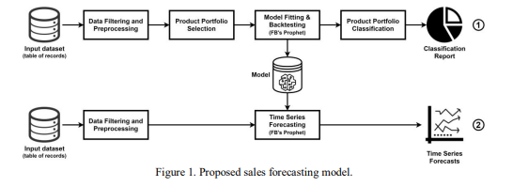
METHODOLOGY

Slide 12
METHODOLOGY
INPUT DATASET
1) item_code
2) date
3) quantity
4) unit_price

Slide 13
METHODOLOGY
DATA FILTERING AND PREPROCESSING
filtering by date, in order to remove irrelevant historical data
conversion of quantities into the same unit
data aggregation in time domain at the product level

Slide 14
METHODOLOGY
PRODUCT PORTFOLIO SELECTION
1) the total profit per product over the last year (if the profit per sale is available, which is a rarity),
2) the total financial turnover (i.e. net sales) per product over the last year (if the unit price per sale is available, which is often a case),
3) the total quantity sold per item over the last year (if none of the aforementioned data is available)

Slide 15
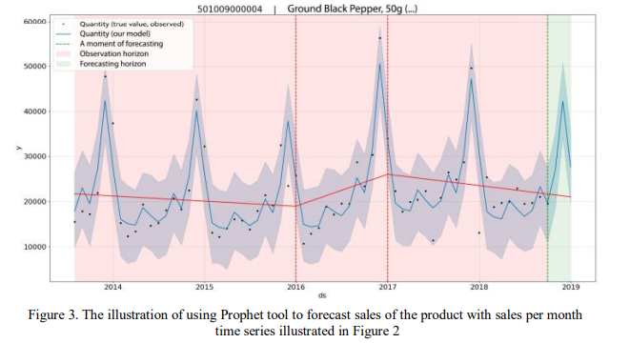
METHODOLOGY:TS FORECASTING EXAMPLE

Slide 16


PERFORMANCE METRICS
The two principles metrics for measuring accuracy of prophet models are:
PE: Percentage error for individual monthly/quarterly forecasts
MAPE: Mean Absolute Percentage Error for a global accuracy

Slide 17
PROPHET ADVANTAGES
It works best with time series that have strong seasonal effects and several seasons of historical data
is robust to missing data and shifts in the trend, and typically handles outliers well.
Prophet is used in many applications across Facebook for producing reliable forecasts and performs better than any other approach in the majority of cases.

Slide 18
PRACTICAL CASE OF PROPHET’s USAGE: SOME RESULTS

Slide 19
PRACTICAL CASE: CLASSIFICATION
The use case here concern a product portfolio which is obtained experimentally in a production environment in one of the biggest retail companies in Bosnia and Herzegovina
The portfolio has 581 products while 400 active over the past year taken from of the experiment moment
selection criterion: total financial turnover per product (200 out of 400 are selected)

Slide 20
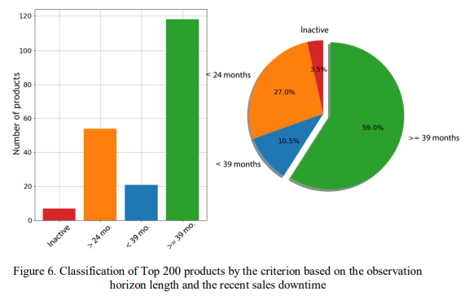
CLASSIFY BY OBSERVATION HORIZON

Slide 21
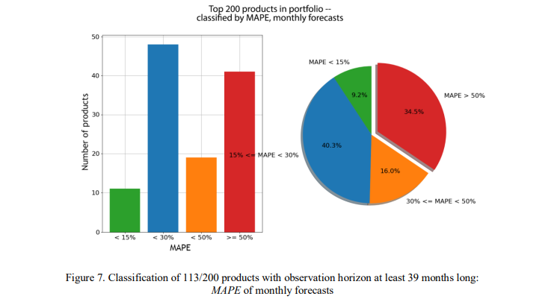
CLASSIFY BY OBSERVATION MAPE INTERVALS

Slide 22
CONCLUSION
Research has shown that no matter the product portfolio:
50% of the product portfolio (with a sufficiently long historical data) can be forecasted with MAPE < 30% on a monthly basis,
while approximately 70% can be forecasted with MAPE < 30% on a quarterly basis (40% of which with MAPE < 15%).
The major lack of Prophet is that it require at least 24 months of active product datas, and in real world , non active products (with a downtime of less than 3 months)represents a non negligible part of the portfolio

Slide 23
THANK YOU

